Slide 1
Welcome

Slide 2

Writing Clear Proposals
Jay Dixit
Storytelling classes | Writing Workshops | Coaching
jay@storytelling.nyc
storytelling.nyc
@jaydixit
Notes:
My story:
Knew I wanted to be a writer…
Rolling Stone
New York Times
Psychology Today
But lonely. Feels like detention. A punishment. Solitary confinement.
So I started teaching.
Now I’m here.

Slide 3
Introductions

Slide 4
Goals and learning objectives

Slide 5
Goal 1
APPLY ANALYTICAL THINKING TO THE PROPOSAL PLANNING PROCESS
Learn to use and apply the Question Method™, a technique for identifying the structure and major points of a document by asking and answering a series of analytical questions
Use the Question Method™ to articulate the purpose of the document
Use the Question Method™ to define the key points for each section
Use the Question Method™ to formulate a logical structure
Notes:
Talk about thinking analytically.
The way you’re used to writing… doesn’t work for this anymore.
5-paragraph essays

Slide 6
Goal 2
WRITE WITH THE READER IN MIND
Write with clarity and precision
Trim for concision

Slide 7
LEARNING METHODS
Lecture
Modeling
Practice
Notes:
You’ll be rewriting the document you brought
you’re coming with a draft of what you’re working on. we’ll start from scratch, start from the very beginning so we can not only improve the current proposal, but so we can know how to start proposals from scratch in the future. you might feel like you already did this, but the point of this isn’t just to perfect what you already did, but to teach you a new way of approaching this in the future.

Slide 8
Criteria for Success
WHAT MAKES A PROPOSAL GOOD?
Organized. Structured so as to make it easy to follow the logic behind it.
Rigorous. You’ve asked and answered the right questions.
Clear. Written in a direct way such that it’s easy for the reviewer to understand.
Concise. Doesn’t ramble or repeat. Gets to the point quickly. No extraneous information.
Data-driven. Provides data demonstrating why the plan is expected to succeed.

Slide 9
Organized.
Structured so as to make it easy to follow the logic behind it.
Notes:
OK. So. We want our documents to be organized. But how do we get there? How do you know how to structure a document?

Slide 10
Thinking
about structure (link)
Notes:
Example: Redfin relocation – Original. Let’s look at the structure of this

Slide 11
Practice
PRACTICE: What’s the structure?
Notes:
Write out the structure use the headings to create an outline of this document so that we can look at the structure from a high level
They can get the idea of this, start grappling with it
5 minutes, get as far as you can
Then I’ll reveal the answer:
Get them to create this:

Slide 12
Debrief

Slide 13
Structure
ORIGINAL STRUCTURE
Executive Summary
Our Immediate Recommendations
Future Recommendation
About the Relocation Customer
Relocating customers are a large segment of good contacts with different needs
Relocating Home Buyers are Under-Represented at Redfin
Contact Conversion and Improved Customer Experience
Improve Identification of Relocatees in Agent Tools
Create 3rd Party Referral Fee Policy
Adjust Agent Events, Roles, and Education
Deal Writing Agents
Support Agents and Relocation Coordinators
Improve Website UX for Relocatees
Reduce Friction for Customers to Contact Agents in Another Market
Relocation Pages and Tools
Contact Generation
Partner with MOVE Guides
Targeted Consumer Marketing
Partnering with corporate talent teams to reach employees
Notes:
How did I do it? I used the headings that are already on there. This document DOES have headings, so that makes it easy to see what the structure IS.
But when I look at the structure, what does it tell me about the flow of information?
Look at the document, describe the flow of information
When I step back from it, and I try to answer these questions:
What’s the flow of information?
What is this document intended to do?
What does each section represent?
It’s unclear.

Slide 14
Practice
PRACTICE: Interpreting the structure
What’s the objective of this document and the main point it’s making?
What’s the logic progression of the document?
What’s the main point of each section?

Slide 15
Debrief

Slide 16
Debrief
THE BENEFITS OF AN EXPLICIT STRUCTURE
Executive Summary
Our Immediate Recommendations
Future Recommendation
About the Relocation Customer
Relocating customers are a large segment of good contacts with different needs
Relocating Home Buyers are Under-Represented at Redfin
Contact Conversion and Improved Customer Experience
Improve Identification of Relocatees in Agent Tools
Create 3rd Party Referral Fee Policy
Adjust Agent Events, Roles, and Education
Deal Writing Agents
Support Agents and Relocation Coordinators
Improve Website UX for Relocatees
Reduce Friction for Customers to Contact Agents in Another Market
Relocation Pages and Tools
Contact Generation
Partner with MOVE Guides
Targeted Consumer Marketing
Partnering with corporate talent teams to reach employees
Notes:
If it’s a good structure, you could step away from it and say something like:
First it gave me the problem then a strategy for solving it then three steps for the strategy then evidence why each of those steps will be work

Slide 17
Critique
ORIGINAL STRUCTURE
Executive Summary
Our Immediate Recommendations
Future Recommendation
About the Relocation Customer
Relocating customers are a large segment of good contacts with different needs
Relocating Home Buyers are Under-Represented at Redfin
Contact Conversion and Improved Customer Experience
Improve Identification of Relocatees in Agent Tools
Create 3rd Party Referral Fee Policy
Adjust Agent Events, Roles, and Education
Deal Writing Agents
Support Agents and Relocation Coordinators
Improve Website UX for Relocatees
Reduce Friction for Customers to Contact Agents in Another Market
Relocation Pages and Tools
Contact Generation
Partner with MOVE Guides
Targeted Consumer Marketing
Partnering with corporate talent teams to reach employees
Notes:
Glancing at this structure, it’s hard to tell what conclusion is being argued for and what points are being made in support of that conclusion.
I don’t even know if it’s a proposal for a strategy to do, or if it’s a summary of how the
company is structured?
It’s hard for me to see from these headings what the flow of the document is

Slide 18
Revised structure
(link)
Notes:
Here’s my revised structure.

Slide 19
Revised
REVISED STRUCTURE
Executive Summary
Immediate recommendations
A future recommendation
Financial projections
Relocating Customers are a Significant Opportunity for Redfin
Relocating customers are a large segment of good contacts
Relocating buyers and sellers are good customers for Redfin
Redfin fails to capture leads among relocating home buyers
Redfin fails to convert relocating customers
Redfin is uniquely positioned to win relocating customers
Objective 1: Increase Conversion Rate of Relocating Buyers and Sellers
Improve identification of relocating customers in Agent Tools
Implement a standard referral fee for third-party referrals
Begin offering “Neighborhood Consultations”
Add a “Relocation Coordinator” role
Add relocation content and features to the Redfin website
Enable relocating customers to contact agents in their destination city
Add website content for relocating customers
Objective 2: Generate Leads Among Relocating Buyers and Sellers
Partner with MOVE Guides
Begin targeted consumer marketing of relocating customers
Partner with corporate talent recruiters
Begin a Redfin Business Ambassador program

Slide 20
Practice
PRACTICE: Interpreting the structure
What’s the objective of this document and the main point it’s making?
What’s the logic progression of the document?
What’s the main point of each section?
Notes:
Now look at what I did this
Divide yourself into 2-man groups find a partner, someone whom you deeply love, and
Now take 3 minutes, say to your partner in
what’s the flow?
what is each section
what’s the relationship between sections?
(Listen in on what they say, then relay the correct ones to the whole group or do redirection if necessary)

Slide 21
Debrief

Slide 22
Debrief
THE BENEFITS OF AN EXPLICIT STRUCTURE
Executive Summary
Immediate recommendations
A future recommendation
Financial projections
Relocating Customers are a Significant Opportunity for Redfin
Relocating customers are a large segment of good contacts
Relocating buyers and sellers are good customers for Redfin
Redfin fails to capture leads among relocating home buyers
Redfin fails to convert relocating customers
Redfin is uniquely positioned to win relocating customers
Objective 1: Increase Conversion Rate of Relocating Buyers and Sellers
Improve identification of relocating customers in Agent Tools
Implement a standard referral fee for third-party referrals
Begin offering “Neighborhood Consultations”
Add a “Relocation Coordinator” role
Add relocation content and features to the Redfin website
Enable relocating customers to contact agents in their destination city
Add website content for relocating customers
Objective 2: Generate Leads Among Relocating Buyers and Sellers
Partner with MOVE Guides
Begin targeted consumer marketing of relocating customers
Partner with corporate talent recruiters
Begin a Redfin Business Ambassador program
Notes:
In the revised version above, I make the logic explicit in the headings, enabling executives to (1) see and understand the argument at a glance, and (2) always know what point is being made in each section.
So you can see that when the structure is strong, it’s easy to say what the flow is because
structure: each heading is logical and builds on what came before
the features that make the structure explicit: the headings are labeled explicitly. So it’s easy to navigate
Descriptive headings are a tool to make the structure explicit

Slide 23
How do bad documents happen?
Notes:
Why is it that we sometimes write a document that’s not as well thought out as it could be?
It’s not because we don’t know what we’re doing, we don’t know the answers, we don’t have the insights.
It’s not because we’re unable to logically think through a strategy.
The problem is that a lot of us are not in the habit, mentally, of breaking down our thinking process into discrete steps.
For those of us who aren’t naturally analytical thinkers, organizing and writing a document is hard because we don’t know where to start.

Slide 24
How not to write a document
The Brain Dump
The Curse of Knowledge
Trying to strategize in your head
Facts without meaning
Notes:
There are a few mistakes that are really common. And almost all of us do them.
Mistakes that lead us to write these disorganized documents.

Slide 25
Mistake 1:
The Brain Dump
Notes:
The first and most common mistake is the brain dump.
What do we do? We sit down and start writing down their thoughts, without organizing first and without any thought about what the reader actually NEEDS to know.
My thought process might look something like this: “OK, where do I start? …Introduction. What should I say in my introduction? I’ll need to make three points, what three points can I make?” And so on.
The result is a brain dump, a rambling and disorganized document that’s poorly organized, hard to follow, and often riddled with logical holes and unanswered questions.
We just write down what we know and keep going until we can’t think of anything else to say.
The FRIDGE metaphor
All the ingredients in your mind
Doing that is kind of like trying to bake a cake by opening your refrigerator, taking out all the food you have in your fridge, beer, mustard, leftover pizza, garlic, chocolate, and putting it in a big bowl. Most of those ingredients aren’t necessary! And in fact they’ll get in the way. Just because you HAVE those ingredients in your fridge – in your mind – doesn’t mean they should all go in the cake.
The key to baking a cake is what you leave out!
The purpose of a document isn’t to put in everything you know.
It’s to tell the reader what they NEED to know.

Slide 26
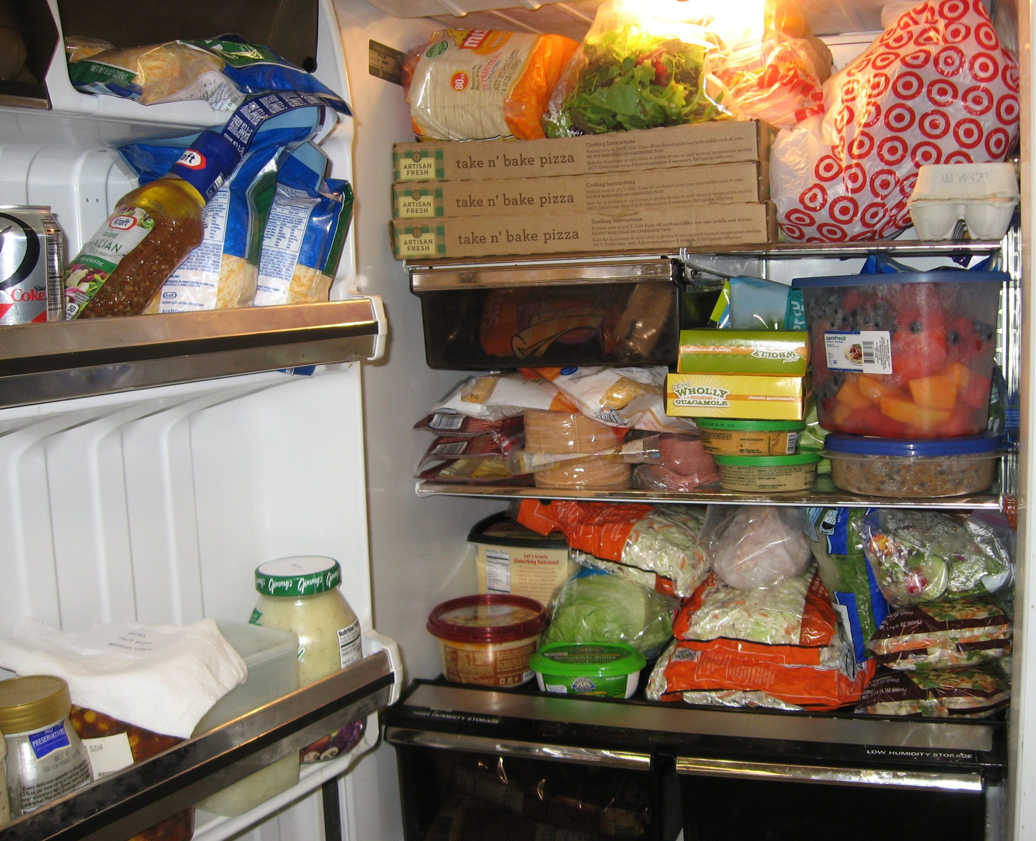

Slide 27
Mistake 2:
The Curse of Knowledge
Notes:
Mistake: just write down what you know, what you can think of to write. I have all this information, let me just write it down.
Write down a heading?
what the curse of knowledge is
knocking thing

Slide 28
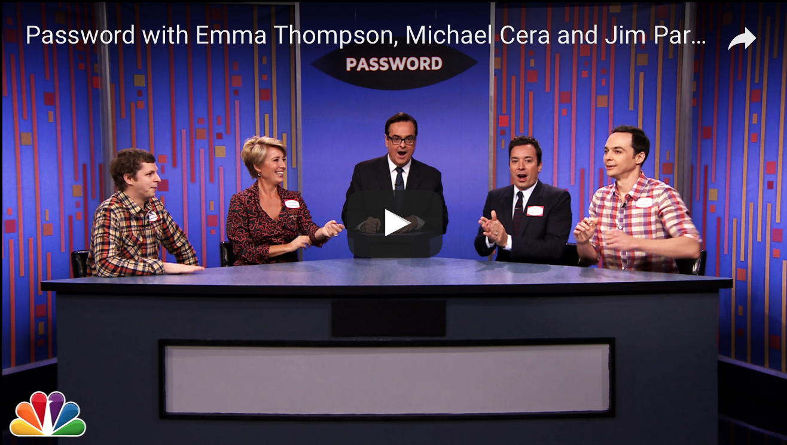
Notes:
Emma Thompson
So what you have to do is ask yourself at every moment, what does the reader know, what does the reader not know?

Slide 29
Mistake 2:
The Curse of Knowledge
Notes:
So what you have to do is ask yourself at every moment, what does the reader know, what does the reader not know?
What different terms mean
when you assume the reader already knows, unconsciously
obviously you do have to guess what the reader knows and don’t knows. But make those determinations consciously, not automatically

Slide 30
Mistake 3:
Trying to strategize in your head
Notes:
Trying to write the finished product directly
Trying to write down only the words that will appear in the final draft.
e.g. you write “introduction” and then you try to write the first sentence… and then the second sentence and then the third sentence.
Driving in the fog. No! Draw a map!
The main mistake people make is they sit down and try to write the finished product, and it comes out however it comes out.
If you only write down the final product… you’re doing all the planning, structuring, organizing in your head.
Then it’s hard to think about what does the reader know, need to know… and when… and how to explain things the best way.
Too much to keep track of!

Slide 31
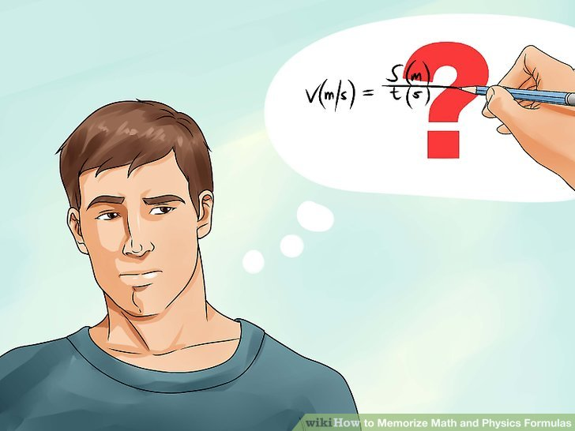
Notes:
It’s like trying to do long division in your head and then only write down the final answer.

Slide 32
Mistake 4:
Facts without meaning
Notes:
When you just start spewing information… without telling the reader WHY you’re telling them and WHY they need to know it.
Never tell the reader information without FIRST telling them why you’re telling it to them.

Slide 33
Notes:
If I just say DB9052JL…
If I tell you it’s the wifi password, and listen carefully because I’m only going to tell it to you once.
But that’s what we tend to do.
Fact
Fact
Fact
Conclusion
WRONG!

Slide 34
“I think deductively. I’m used to doing fact, fact, fact, and then conclusion.” —John
FACTS WITHOUT MEANING
We all are—that’s why we must separate the thinking file from the final document
Writing with the reader in mind requires inverting that order for the reader
Withholding the meaning until the end makes readers confused and bored
Instead we orient the reader by stating the significance at the beginning
Until the reader knows the meaning, facts and figures are meaningless
Stating the meaning at the outset creates context for the facts that follow
Notes:
“I think deductively. I’m used to doing fact, fact, fact, and then conclusion.” —John
Exactly. We all think that way.
Fact, fact, fact, premise, premise, conclusion. That’s how we think.
And that’s the difference between writing for yourself, and writing with the reader in mind. Because that is how you think. Facts lead to a conclusion.
But you can’t do that with the reader. If you walk up to someone and you say, “Hey, I’m going to tell you 10 facts, and at the end of those 10 facts I’ll tell you the conclusion I promise,” they’re going to zone out.
Because (1) it’s boring, and then (2) they won’t be able to memorize those facts and remember them later on anyway.
Instead of telling them random facts without telling them why, you FIRST have to tell them the conclusion. “Hey, I have a suggestion for the company. Here’s what my idea is. And THEN you tell them, and here are the reasons I think it will work, here are the facts that justify my conclusion.

Slide 35
Break
10:30 – 10:45 am

Slide 36
Outlining isn’t enough
How do you know what to put in an outline?
Notes:
You can’t just outline. Because how do you know what to put in the outline? You don’t want to just write the final draft of the outline from the beginning.
Otherwise it’s the same problem again. You’re trying to write the final draft of the outline in the first go.
Then you’re just passing the same problem down the chain. How do you figure out what to put in your outline?
Before you start outlining, you need to know what the structure should be.
You need to plan the structure, weigh options
Before you outline, you need to know WHAT you’re trying to say and HOW you want to say it.
You need to think even before you outline!

Slide 37
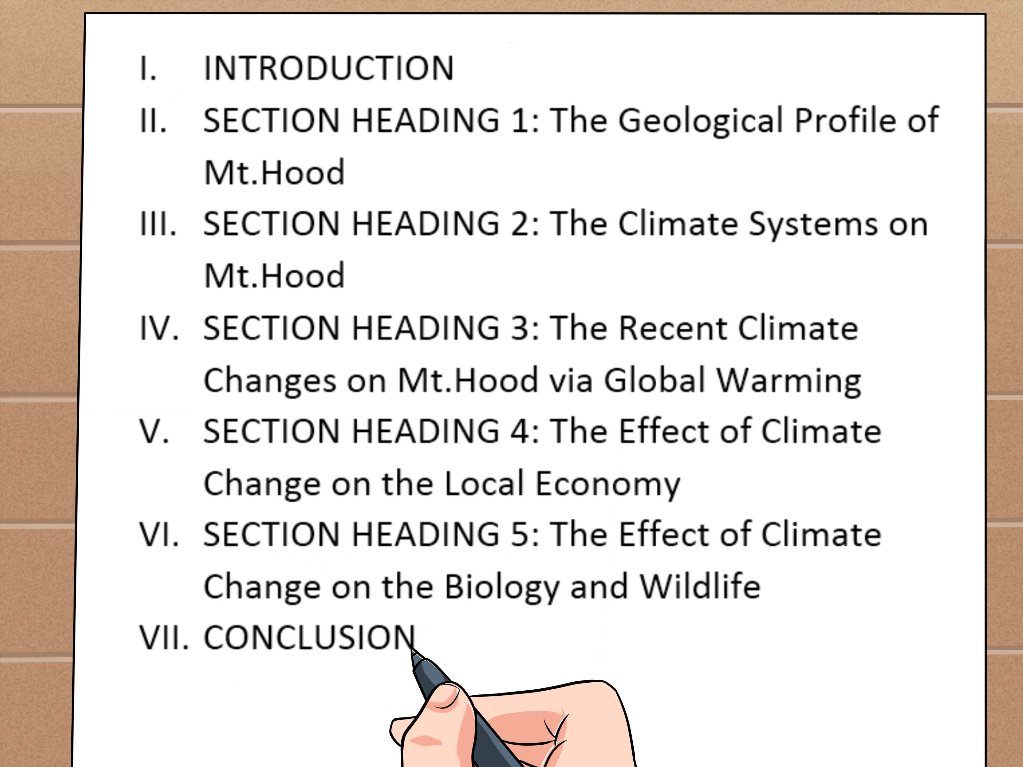
Notes:
Outline strategically!
When you’re outlining, you’re still kind of in the mode of listing
Yes, you’re ordering things, rearranging them…
But you need to dig even deeper than that. You need to be thinking strategically about what to put in or not put in, how to present information to the reader
It means you’re trying to do all that thinking in your head.

Slide 38
Thinking is the first step to clear writing
The main problem with business writing is a lack of clarity
Writing is thinking on paper
Clear thinking ➔ clear writing
Notes:
If the writing is sloppy, the thinking is sloppy too
clear writing requires clear thinking
writing is thinking on paper
it’s a lack of clarity not only in the sentences, but in the thinking itself
I teach a method for clear thinking

Slide 39
How to think analytically
Notes:
How do you think clearly, analytically, strategically?
Thinking is just asking and answering questions
do the whole Tony robbins thing
Analytical thinking is the process of asking and answering questions.
If I can figure out what questions to ask, I find I often already know the answers.
Analytical thinking is really just the process of asking and answering questions. If you can ask the right questions and then answer them, that means you have a logical argument.

Slide 40
How to think analytically
Analytical thinking is the process of asking and answering questions.
Notes:
How do you think clearly, analytically, strategically?
Thinking is just asking and answering questions
Analytical thinking is the process of asking and answering questions.
Analytical thinking is really just the process of asking and answering questions. If you can ask the right questions and then answer them, that means you have a logical argument.
If I can figure out what questions to ask, I find I often already know the answers.

Slide 41
How to write clearly
asking good questions ➔ good answers ➔ clear thinking ➔ clear writing

Slide 42
A technique for thinking clearly
Notes:
Is what I’ll teach you here today

Slide 43
Notes:
Instead of trying to write in your head…

Slide 44
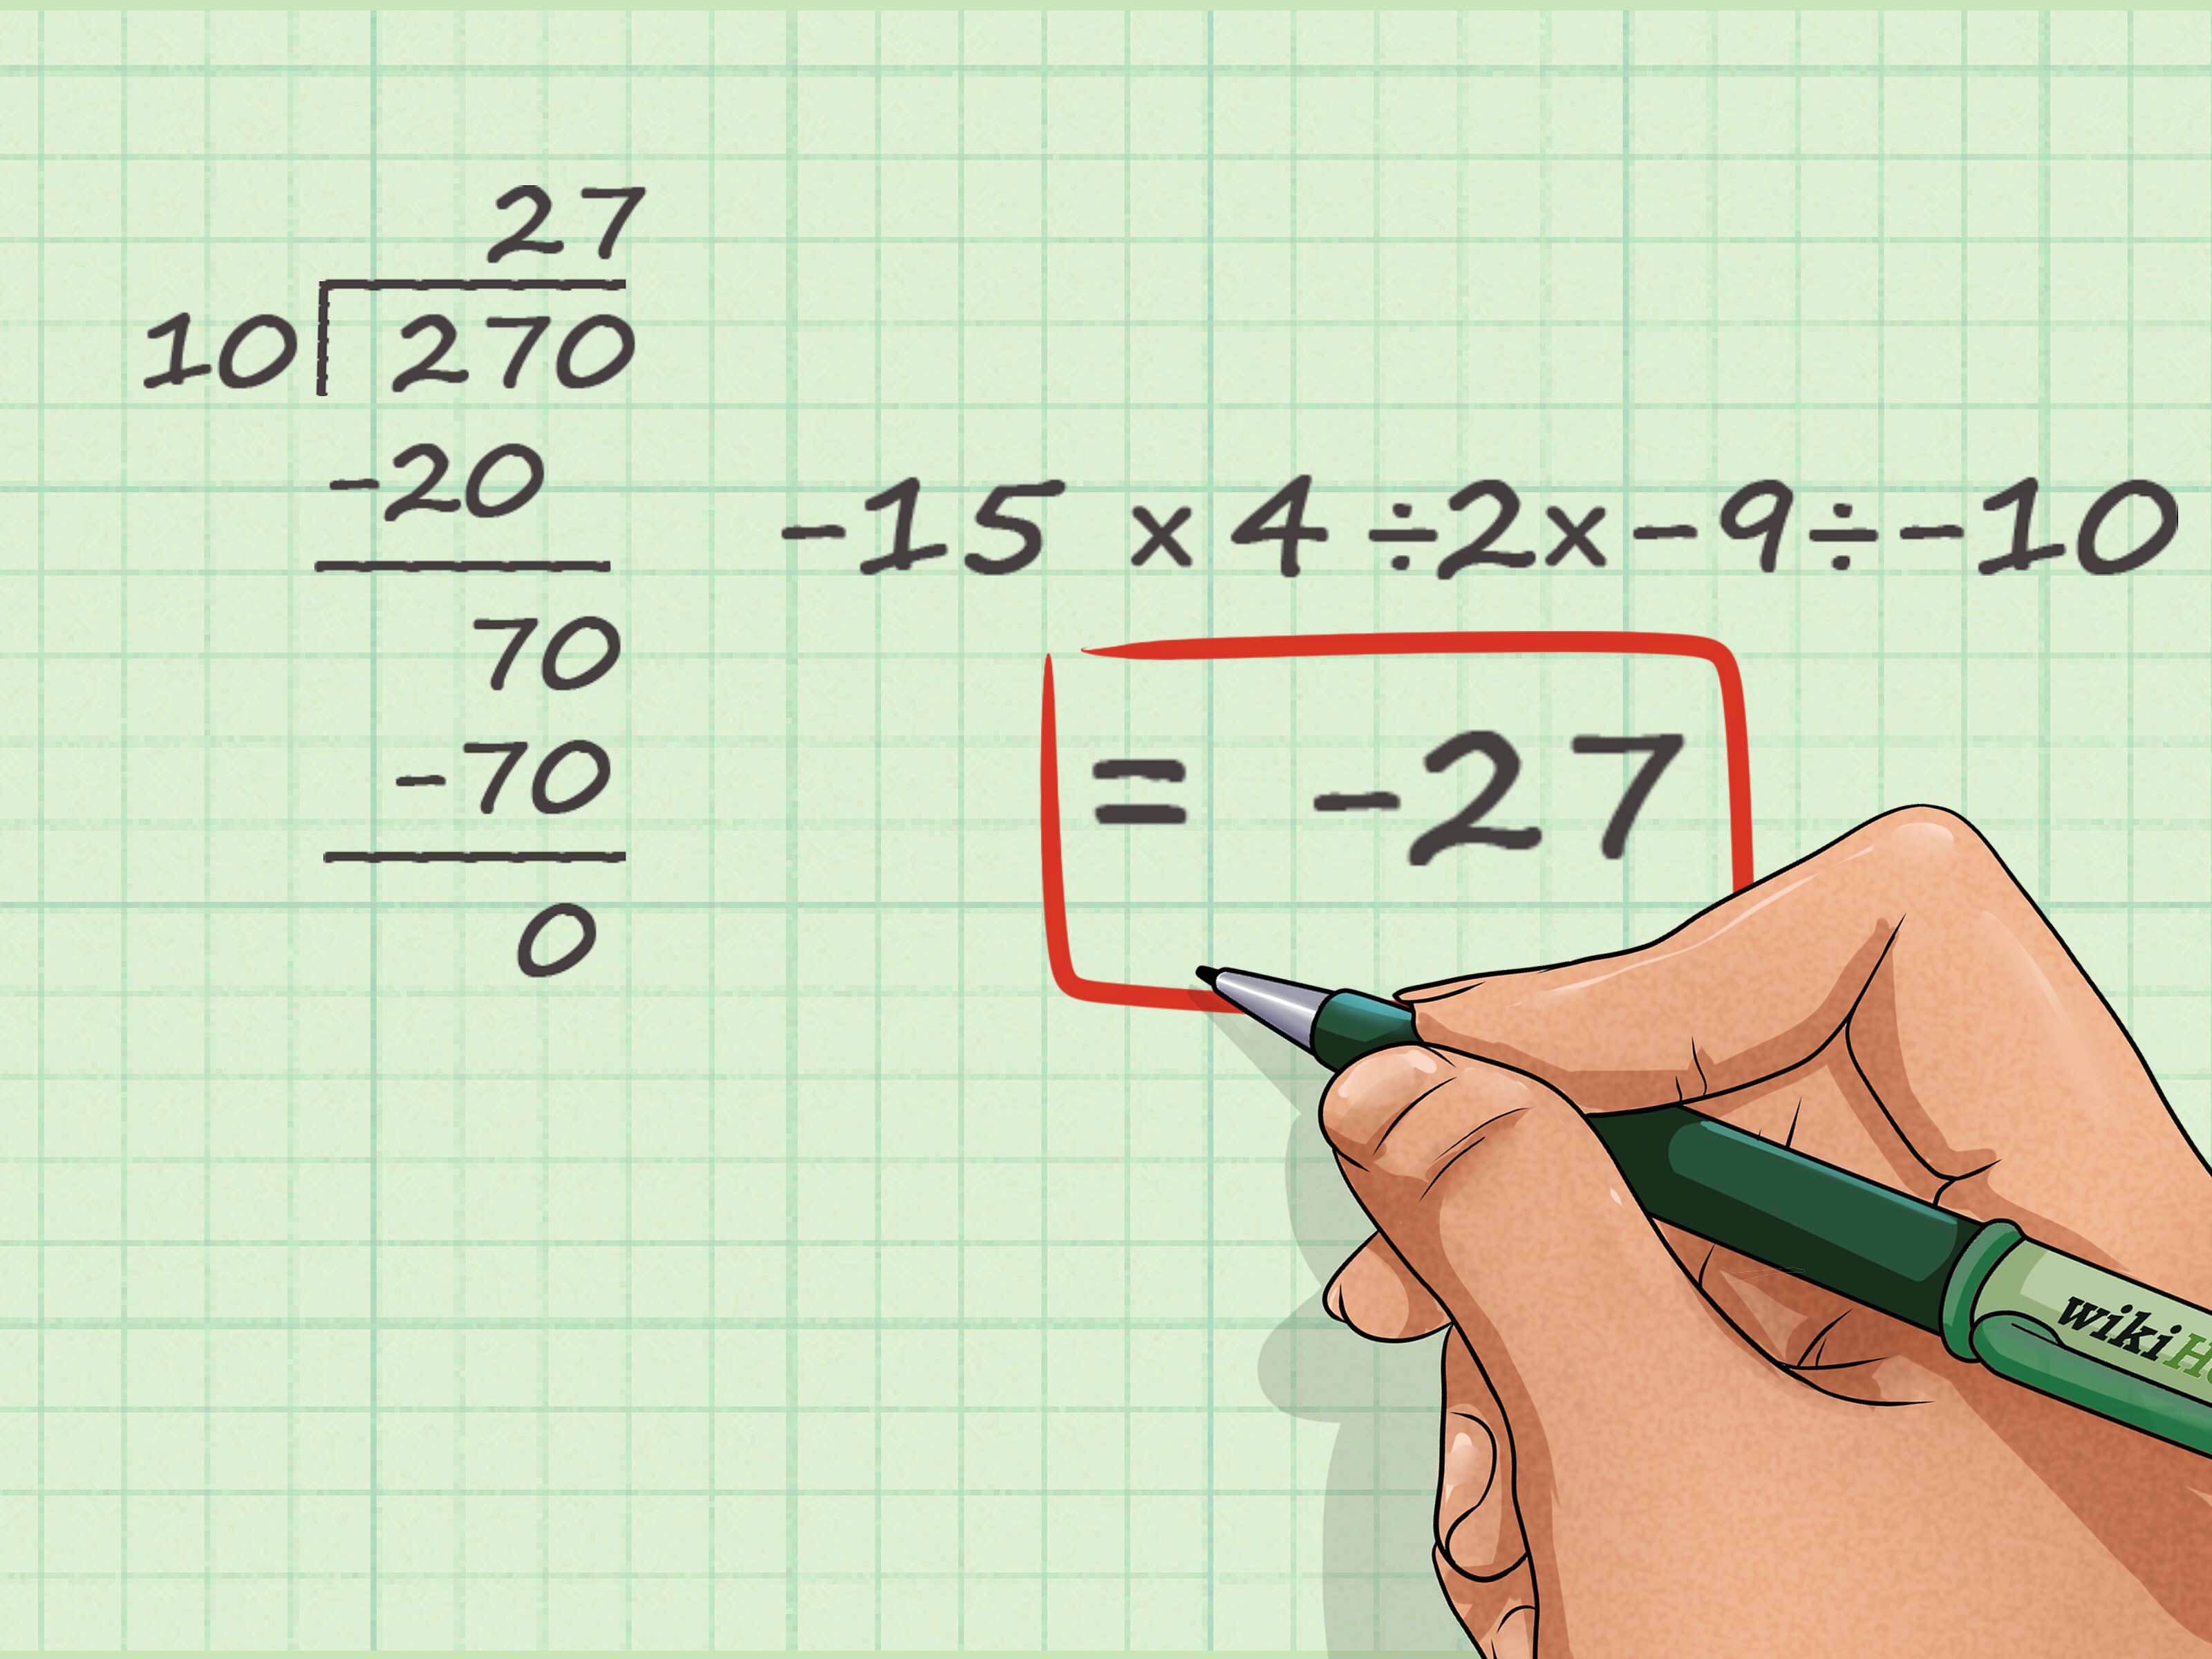
Notes:
I’m going to teach you long division.

Slide 45
A technique for thinking clearly
Notes:
So how do you do that?

Slide 46
FIRST STEP: Create two separate documents
Your thinking file
The (first draft of) the final document you’ll present to the reader
Notes:
Your thinking file. You figuring out for yourself what to put in and how to communicate it, ordering. This isn’t even a draft. This is strategy. your notes to yourself
The document you’ll present to the reader. First draft, second draft.

Slide 47
Jay Dixit’s Process for Writing Clearly
Think
Outline
Write
Rewrite (for clarity)
Trim (for concision)

Slide 48
Jay Dixit’s Process for Writing Clearly
Think strategically and analytically using the Question Method™
Outline
Write
Rewrite (for clarity)
Trim (for concision)
Ask the right questions
Answer those questions

Slide 49
How do you know what questions to ask?

Slide 50
JAY DIXIT’S QUESTION METHOD™
Notes:
The Question Method™ is a tool I developed to prompt you to ask and answer the right questions. The goal is to give you a step-by-step process for thinking analytically.
Analytical thinking is the process of asking and answering questions.

Slide 51
JAY DIXIT’S QUESTION METHOD™
Start by writing: “What question is this document trying to answer?”
Whenever you know the answer to a question, write down the answer
If you don’t know the answer, think what other question you’d need to answer to get there. write down that new question
4. As new questions arise, write those down too
5. Go to #2
6. Continue asking and answering questions until all questions are answered and you can’t think of any more relevant questions
Notes:
a tool I developed to get you to ask and answer the right questions
The goal is to give you a step-by-step process for thinking analytically.
By the end of the process, you’ll have a comprehensive list of questions and answers you can draw on in writing your document.
To figure out what the important questions are

Slide 52
Demo: Jay Dixit’s Question Method™

Slide 53
Demonstration
What question is this document trying to answer?
The question this document is trying to answer is: Should we reduce our agents’ commission to 1% nationwide?
OK, so, should we?
To answer that question, we need to ask: Is that plan likely to succeed?
So, is it? likely to succeed?
To answer that question, we need to ask: Succeed at what? What’s the objective of the plan?
OK, so what is the objective?
The objective is to increase our market share throughout the country.
OK, so will the plan succeed in increasing our market share?
Yes, we think it might.
Why do we think it might? What data do we have?
We think this approach might increase our market share because our consumer research is telling us that sellers are price conscious and want to save as much money as possible on the sale. So, we have a hypothesis that maybe if we cut our commission to 1%, which is 33% to 50% off the standard commission that other agents charge, we might increase our market share.
OK, and have we tested this hypothesis?
Yes, we tested it for 2 years in a few smaller markets.
OK, and what did those tests find?
That test found that we did indeed grow market share faster in the markets where we reduced our commissions.
OK, and do we have any data suggesting that we shouldn’t reduce our commissions or that it wouldn’t work?
No, the experiment we ran pointed strongly in favor of reducing our commissions.
OK, and are there any downsides to reducing our commissions?
etc
Notes:
See how you don’t even get to an answer until you really drill down into the questions

Slide 54
Demo: Jay Dixit’s Question Method™
What’s the objective of this document?
To lay out a strategy for doing a better job of capturing value from relocating customers.

Slide 55
Demo: Jay Dixit’s Question Method™
Why do we want to do a better job?
we’re not doing a good job of capturing them now
because they’re a huge opportunity

Slide 56
Demo: Jay Dixit’s Question Method™
How are we not doing a good job of capturing them now?
we’re not capturing new leads
we’re not converting

Slide 57
Demo: Jay Dixit’s Question Method™
Why do we think they’re a huge opportunity?
relocating customers are a large segment of good contacts
relocating customers are good customers for us
we’re uniquely positioned to win relocating customers

Slide 58
Demo: Jay Dixit’s Question Method™
Well OK so what could we do better?
generating leads
converting existing leads

Slide 59
Demo: Jay Dixit’s Question Method™
What’s our strategy for doing better in those two areas?
to increase conversion rates:
Improve identification of relocating customers in Agent Tools
Implement a standard referral fee for third-party referrals
Begin offering “neighborhood consultations”
Add a “Relocation Coordinator” role
Add relocation content and features to the Redfin website

Slide 60
Demo: Jay Dixit’s Question Method™
What’s our strategy for doing better in those two areas?
for generating leads
Partner with MOVE Guides
Begin targeted consumer marketing of relocating customers
Partner with corporate talent recruiters
Begin a Redfin Business Ambassador program

Slide 61
Practice
PRACTICE: The Question Method™
Run the Question Method™ on the document you brought

Slide 62
Debrief

Slide 63
QUESTIONS CHECKLIST: Have you answered the critical questions?
What are some critical questions?

Slide 64
QUESTIONS CHECKLIST: Have you answered the critical questions?
What are some critical questions?

Slide 65
Debrief

Slide 66
Debrief
QUESTIONS CHECKLIST: Have you answered the critical questions?
What’s my goal in this document?
What am I trying to say?
Where are we today, where do we want to be in the future?
How do I propose that we get there?
What’s the problem I’m trying to solve?
What solution am I proposing?
Why do I think this will work?
What evidence do I have to back up my assertions?
How will we keep track of progress, assess performance?
Notes:
Do an audit of what you just wrote. It should address all of these questions. If not, answer them separately.
Each of these questions will spur other questions.
You can repeat The Question Method™ for any of these.

Slide 67
Debrief
QUESTIONS CHECKLIST
Is this big enough to matter?
Who benefits? The team? The customer?
How does this improve the customer experience?
What is this displacing?
What are potential unintended consequences?

Slide 68
Practice
PRACTICE: QUESTIONS CHECKLIST - For a memo
What are some critical questions for a memo?

Slide 69
Debrief

Slide 70
Debrief
QUESTIONS CHECKLIST: For a memo
How will we win?
What’s the plan?

Slide 71
Practice
PRACTICE - QUESTIONS CHECKLIST - For an update
What are some critical questions?

Slide 72
Debrief
QUESTIONS CHECKLIST: For an update
What’s our current status?

Slide 73
Lunch 11:45 AM–12:45 PM

Slide 74
STRUCTURING A DOCUMENT
Learning objective: Use the Question Method™ to formulate a logical structure
Notes:
Outlining and organizing
How to organize a document in a logical way.

Slide 75
CREATING A HIERARCHIACAL DOCUMENT STRUCTURE
Take the questions from the Question Method™
Put them in a logical order
Identify relevant sub-questions

Slide 76
THE QUESTION METHOD™
What’s the objective of this document?
To lay out a strategy for doing a better job of capturing value from relocating customers.
Why do we want to do a better job?
we’re not doing a good job of capturing them now
because they’re a huge opportunity
How are we not doing a good job of capturing them now?
we’re not capturing new leads
we’re not converting
Why do we think they’re a huge opportunity?
relocating customers are a large segment of good contacts
relocating customers are good customers for us
we’re uniquely positioned to win relocating customers
Well OK so what could we do better?
generating leads
converting existing leads
What’s our plan for doing better in those two areas?
To increase conversion rates:
Improve identification of relocating customers in Agent Tools
Implement a standard referral fee for third-party referrals
Begin offering “neighborhood consultations”
Add a “Relocation Coordinator” role
Add relocation content and features to the Redfin website
For generating leads:
Partner with MOVE Guides
Begin targeted consumer marketing of relocating customers
Partner with corporate talent recruiters
Begin a Redfin Business Ambassador program
Notes:
How do you create an outline?
assemble your list of important questions, both the standard ones and the ones you generated. Only the ones that are relevant to the objective of the doc
put them in order
that’s your outline

Slide 77
HIERARCHICAL DOCUMENT OUTLINE
Relocating customers are a significant opportunity for Redfin
Relocating customers are a large segment of good contacts
Relocating buyers and sellers are good customers for Redfin
Redfin fails to capture leads among relocating home buyers
Redfin fails to convert relocating customers
Redfin is uniquely positioned to win relocating customers
Objective #1: Increase conversion rate of relocating buyers and sellers
Improve identification of relocating customers in Agent Tools
Implement a standard referral fee for third-party referrals
Begin offering “Neighborhood Consultations”
Add a “Relocation Coordinator” role
Add relocation content and features to the Redfin website
Enable relocating customers to contact agents in their destination city
Add website content for relocating customers
Objective #2: Generate leads among relocating buyers and sellers
Partner with MOVE Guides
Begin targeted consumer marketing of relocating customers
Partner with corporate talent recruiters
Begin a Redfin Business Ambassador program
Notes:
If you’re confused by document structure, here’s the thing you need to remember: Each section must be asking and answering a question.

Slide 78
Practice
PRACTICE: Creating a hierarchical document structure
Notes:
Do that with the questions you did.

Slide 79
Debrief

Slide 80
HEADING WORKSHOP
Notes:
The headings are very important
Tell the reader where they are in the document, how the logic flows
Tell them what point you are making so they understand why you are giving them information.
So, how should you title the headings so they’ll be as informative as possible?

Slide 81
HOW TO TITLE YOUR HEADINGS
use explicit headings to make it clear what the point of the section is
verbs are clearer and more forceful than nouns
longer, more informative headings are clearer
headings of the same level should be grammatically parallel
questions for the board should be phrased as questions
recommendations should be phrased as recommendations
Notes:
Contact and website example from Relocation document

Slide 82
DEMO: Original Heading Title
Adjust Agent Events, Roles, and Education
Deal Writing Agents: Agents report that relocatees tour homes inefficiently at the start of their search because they have not yet narrowed their neighborhood focus. We recommend creating a new event called a “Neighborhood Consultation” that would delight customers, reduce customer search time and increase tour-to-close conversion. We think the event will, at minimum increase conversion from an estimated 30% to 32%, generating ~200 more closes per year and increasing revenue by $2M.
Notes:
If a section of the document is recommending that a particular action be taken, it’s clearer if the heading itself is phrased as a recommendation. Generally, using verbs is clearer and more forceful than listing nouns.
Take the heading Deal Writing Agents. This section is actually making an important recommendation: that Redfin should begin offering Neighborhood Consultations. But this is not apparent from the heading.

Slide 83
DEMO: Revised Heading Title
Begin offering “Neighborhood Consultations”
One thing that makes relocating customers different is that they don’t know what neighborhood to move to in their new city. Indeed, agents report that relocatees tour homes inefficiently at the start of their search because they have not yet narrowed their neighborhood focus.
We recommend creating a new event called a “Neighborhood Consultation,” which would delight customers, reduce customer search time, and increase tour-to-close conversion. We think the event will, at minimum increase conversion from an estimated 30% to 32%, generating ~200 more closes per year and increasing revenue by $2M.
Notes:
I changed the heading to Begin offering Neighborhood Consultations to make it more clear what point is being made.

Slide 84
DEMO: Original Heading Title
Adjust Agent Events, Roles, and Education
Support Agents and Relocation Coordinators Support Agents rarely book both a tour and listing consult for the same customer. This is an incentive-related problem that applies broadly, but it is a particularly acute issue with relocating customers. This is both because relocatees are unfamiliar with their destination city and because Support Agents don’t know DWAs or booking protocols outside their market.
We recommend creating a HUB-based Relocation Coordinator (RC) role. The RC will be an expert in booking all event types for any Redfin market and will be familiar with our relocation-specific resources, such as Opportunity Score and neighborhood pages. Support Agents and Tour Coordinators will route relocation calls to the RC who could set up the appropriate events in both regions. At first, this might be a part time position for 3-4 Support Agents. Alternatively, if the proposed Redfin VIP program is implemented, the role could be handled by a VIP Agent. The VIP program has also specified an algorithm-based tool which would allow a VIP Agent or RC to find and schedule the right agent in any market. We strongly support the development of this tool.
Notes:
Likewise, the heading “Support Agents and Relocation Coordinators” is also hiding an important recommendation: that Redfin should add the role of Relocation Coordinator.

Slide 85
DEMO: Revised Heading Title
Add a “Relocation Coordinator” role
Support Agents rarely book both a tour and listing consult for the same customer. This is an incentive-related problem that applies broadly, but it is a particularly acute issue with relocating customers. This is both because relocatees are unfamiliar with their destination city and because Support Agents don’t know DWAs or booking protocols outside their market.
We recommend creating a HUB-based Relocation Coordinator role. The Relocation Coordinator will be an expert in booking all event types for any Redfin market and will be familiar with our relocation-specific resources, such as Opportunity Score and neighborhood pages. Support Agents and Tour Coordinators will route relocation calls to the Relocation Coordinator, who will then set up the appropriate events in both regions.
Notes:
I changed the heading to Add a Relocation Coordinator role. This is a key recommendation of the document, and it should be labeled clearly so the reader knows what’s in the section and where it fits into the larger argument.

Slide 86
How do I know what to say within each section?

Slide 87
OPENING AND FRAMING
Goal 2: Writing with the reader in mind
Notes:
Now when you’ve done this for the whole document, you do the same thing for each section. Macro/ micro
The Question Method™ is mirrored on a micro scale.

Slide 88
EXPLICITNESS AND CLARITY
Learning objective: Write with explicitness and clarity

Slide 89
Using the Question Method™ within each section
Learning objective: Use the Question Method™ to define the key points within each section
Notes:
Now when you’ve done this for the whole document, you do the same thing for each section. Macro/ micro
The Question Method™ is mirrored on a micro scale.

Slide 90
1. All documents are FAQs
Every section must be asking and answering a question

Slide 91
Using the Question Method™ within each section
Your stating point is always the same:
What question am I trying to answer in this section?
Notes:
I want to teach you to say to yourself, as they’re creating the document structure, “This section answers the question: What steps would we need to take to implement this plan?” “This section answers the question: Why do I think this plan will work?”

Slide 92
Practice
PRACTICE: What am I saying in each of these paragraphs?
Notes:
Do it on your own document.

Slide 93
Debrief

Slide 94
2. EXPLICITNESS: Tell the reader why they’re reading what they’re reading
Notes:
For writing to be clear, the reader must not only understand the information, but must also why each piece of information is relevant to the broader argument. To put it another way: A proposal document should make a series of points, not just provide background information.
The reader has to know why they need to know this
relocation example—relevance
For example, the “About the Relocation Customer” section is confusing because it’s not clear how the information is relevant. Take this part:
"Relocatees have three traits that make them different from people moving within the same city... (1) They don't know where to move in their new city." What point is being made here? The reader will read this and think, “OK, and…? OK, so relocating customers don’t know where to move in their new city. So what? What about it?”
But instead of going on to provide a “so what” and explain why this information is significant, the document goes on to list other factoids about relocating customers.
It seems like the information in the “About the Relocation customer” section is merely background for what is to come later. But if you want the reader to register information, it should be provided only at the point where it’s relevant, not before.
To me, the place where the information above is actually relevant is later, in the section recommending that Redfin begin offering Neighborhood Consultations. In that part of the document, it does make sense to point out that relocating customers don’t know where to move in their new city. In this context, the information actually is relevant because it’s a statement about a problem with the current way of doing things—a problem to which Neighborhood Consultations are the solution.

Slide 95
2. EXPLICITNESS: Tell the reader why they’re reading what they’re reading
Never make the reader read something without telling them why it’s important.

Slide 96
2. EXPLICITNESS: Tell the reader why they’re reading what they’re reading
Example: Redfin Relocation
Notes:
For writing to be clear, the reader must not only understand the information, but must also why each piece of information is relevant to the broader argument. To put it another way: A proposal document should make a series of points, not just provide background information.
The reader has to know why they need to know this
relocation example—relevance For example, the “About the Relocation Customer” section is confusing because it’s not clear how the information is relevant. Take this part:
"Relocatees have three traits that make them different from people moving within the same city... (1) They don't know where to move in their new city." What point is being made here? The reader will read this and think, “OK, and…? OK, so relocating customers don’t know where to move in their new city. So what? What about it?”
But instead of going on to provide a “so what” and explain why this information is significant, the document goes on to list other factoids about relocating customers.
It seems like the information in the “About the Relocation customer” section is merely background for what is to come later. But if you want the reader to register information, it should be provided only at the point where it’s relevant, not before.
To me, the place where the information above is actually relevant is later, in the section recommending that Redfin begin offering Neighborhood Consultations. In that part of the document, it does make sense to point out that relocating customers don’t know where to move in their new city. In this context, the information actually is relevant because it’s a statement about a problem with the current way of doing things—a problem to which Neighborhood Consultations are the solution.

Slide 97
2. EXPLICITNESS: Tell the reader why they’re reading what they’re reading
Begin offering “Neighborhood Consultations”
One thing that makes relocating customers different is that they don’t know what neighborhood to move to in their new city. Indeed, agents report that relocatees tour homes inefficiently at the start of their search because they have not yet narrowed their neighborhood focus.
We recommend creating a new event called a “Neighborhood Consultation,” which would delight customers, reduce customer search time, and increase tour-to-close conversion. We think the event will, at minimum increase conversion from an estimated 30% to 32%, generating ~200 more closes per year and increasing revenue by $2M.

Slide 98
PARAGRAPHS – What does it mean to have the reader in mind?
Orient the reader within a sentence or paragraph
Curse of knowledge
Need to know basis

Slide 99
TRANSFERABLE STRATEGIES: USE PRECISE WORDS
Pause and ask yourself:
”What am I really trying to say?”
“How would I explain this to a friend?
Notes:
What does it mean to service these customers “cleanly”? That’s not a standard term and it’s not clear what it means.

Slide 100
DEMO: USE PRECISE WORDS
Reduce Friction for Customers to Contact Agents in Another Market
We don’t cleanly service a client who has worked with Redfin in one market and wants to buy in another. This customer is surprisingly common.
Notes:
What does it mean to service these customers “cleanly”? That’s not a standard term and it’s not clear what it means.

Slide 101
Practice
PRACTICE: “What am I trying to say?”
Reduce Friction for Customers to Contact Agents in Another Market
We don’t cleanly service a client who has worked with Redfin in one market and wants to buy in another. This customer is surprisingly common.
Notes:
What does it mean to service these customers “cleanly”? That’s not a standard term and it’s not clear what it means.

Slide 102
DEBRIEF: “What am I trying to say?”
Currently, we don’t provide an easy way for relocating clients who have already worked with Redfin to start working with us again in their new city. Yet these customers are surprisingly common.

Slide 103
USE ACTIVE VERBS
Notes:
DEMO: USE ACTIVE VERBS RATHER THAN “TO BE” VERBS

Slide 104
USE ACTIVE VERBS
The partial participation of newcomers is by no means “disconnected” from the practice of interest. Furthermore, it is also a dynamic concept. In this sense, peripherality, when it is enabled, suggests an opening, a way of gaining access to sources for understanding through growing involvement. The ambiguity inherent in peripheral participation must then be connected to issues of legitimacy, of the social organization of and control over resources, if it is to gain its full analytical potential.
Notes:
DEMO: USE ACTIVE VERBS RATHER THAN “TO BE” VERBS

Slide 105
USE ACTIVE VERBS
Most scientific theories rebuff common sense. They call on evidence beyond the reach of our senses and overturn the observable world. These theories tax, affront, and exhilarate the people who first encounter them, but 50 years later they are taken for granted and considered to be common sense, like the idea that the earth revolves around the sun despite what we see with our eyes.
Notes:
DEMO: USE ACTIVE VERBS RATHER THAN “TO BE” VERBS

Slide 106
DEMO: AVOID NOMINALIZATIONS
Notes:
DEMO: USE ACTIVE VERBS RATHER THAN “TO BE” VERBS

Slide 107
DEMO: AVOID NOMINALIZATIONS
The rise of the planet's temperature is a result of greenhouse gases.

Slide 108
DEMO: AVOID NOMINALIZATIONS
The proliferation of nominalizations in a discursive formation may be an indication of a tendency toward pomposity and abstraction.

Slide 109
DEMO: AVOID NOMINALIZATIONS
The proliferation of nominalizations in a discursive formation may be an indication of a tendency toward pomposity and abstraction.

Slide 110
DEMO: AVOID NOMINALIZATIONS
Writers who use a lot of nominalizations in their sentences sound pompous and abstract.

Slide 111
DEMO: AVOID NOMINALIZATIONS
Greenhouse gases are causing the the planet’s temperature to rise.

Slide 112
DEMO: AVOID NOMINALIZATIONS
Greenhouse gases are raising the planet’s temperature.

Slide 113
DEMO: AVOID NOMINALIZATIONS
Prevention of neurogenesis diminished social avoidance in mice.

Slide 114
DEMO: AVOID NOMINALIZATIONS
When we prevented neurogenesis, the mice stopped avoiding other mice.

Slide 115
DEMO: AVOID NOMINALIZATIONS
Participants read assertions whose veracity was either affirmed or denied by the subsequent presentation of an assessment word.

Slide 116
DEMO: AVOID NOMINALIZATIONS
We showed people a sentence, followed by the word TRUE or FALSE.

Slide 117
DEMO: AVOID NOMINALIZATIONS
CARBON MONOXIDE WARNING
Mild Exposure to CO can result in accumulated damage over time.
Extreme Exposure to CO may rapidly be fatal without producing significant warning symptoms.
Infants, children, older adults, and people with health conditions are more easily affected by carbon monoxide and their symptoms are more severe.

Slide 118

WARNING! Using your generator inside CAN KILL YOU IN 5 MINUTES.
Generator exhaust contains carbon monoxide. This is a POISON YOU CANNOT SEE OR SMELL.
NEVER use your generator inside a home or garage, EVEN IF the doors and windows are open.
Only use it OUTSIDE and far away from windows, doors, and vents.

Slide 119
DEMO: AVOID NOMINALIZATIONS
2017 Direct Marketing: How Big Can It Get?
Notes:
Sentence Workshop

Slide 120
WHAT TO LOOK FOR
use precise words
use active verbs rather than to be verbs
avoid nominalizations
Notes:
So what do I want you to take away from this?
use precise words
use active verbs rather than to be verbs when possible
avoid nominalizations

Slide 121
Break 3:00–3:15

Slide 122
EDITING AND TRIMMING
Learning objective: Trim for concision

Slide 123

EDITING AND TRIMMING

Slide 124
TRANSFERABLE STRATEGIES: Tricks for cutting
Learning objective: Trim for concision
Notes:
No real trick, just give yourself permission
The main step is to do it as a separate step:
It can be freeing: Like decluttering

Slide 125
TRANSFERABLE STRATEGIES: Tricks for cutting
mentally switch modes
print it out and use a red pen
pretend it’s someone else’s writing

Slide 126
EDITING AND TRIMMING
Notes:
As the great writing teacher William Zinsser said, the essence of writing is rewriting. The reality is that revising and editing makes the difference between writing that’s clear, tight, and concise vs. writing that’s meandering.
In this section I teach employees how to go back after they’ve written a draft and read it with fresh eyes; how to compare a document to the original outline and look for holes; how to trim the fat and leave only what’s needed; tricks like printing out a hardcopy and using a different colored pen; and how to “switch modes” from creator to critic so you can look for vague, confusing, or insufficiently supported passages and address them.
0:26:14 reset

Slide 127
Practice
PRACTICE: What can I delete?

Slide 128
Debrief

Slide 129
Application: Action planning

Slide 130
Review sample proposal
Notes:
e.g. they need to start with The Question Method™ because they really haven’t defined what they’re trying to convince the reader of
Look at relocation proposal

Slide 131
CREATE AN ACTION PLAN FOR SAMPLE PROPOSAL

Slide 132
WORKSHOP: PUTTING IT ALL TOGETHER
Rewrite the document you brought

Slide 133
Closing

Slide 134
Summary of Learning

Slide 135
The end

Slide 136
Writing Clear Proposals
Jay Dixit - Storytelling NYC
Storytelling classes | Writing Workshops | Coaching
jay@storytelling.nyc
www.storytelling.nyc
@jaydixit

